Slide 1
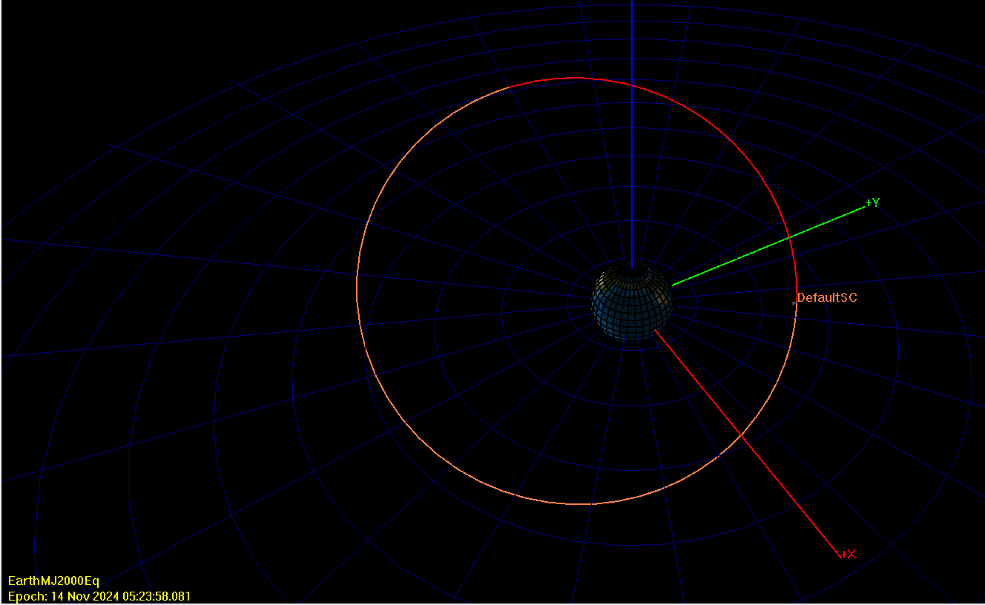









$${\overline{v}}_{2}$$
L.H
$$γ_{2}$$
$${\overline{r}}_{2}$$
$$2$$
$${\overline{v}}_{1}$$
$$θ_{2}^{∗}$$
$$γ_{1}$$
$${\overline{r}}_{1}$$
Line of Nodes
$$θ_{1}^{∗}$$
$${\overline{r}}_{p}$$
L.H

Slide 2
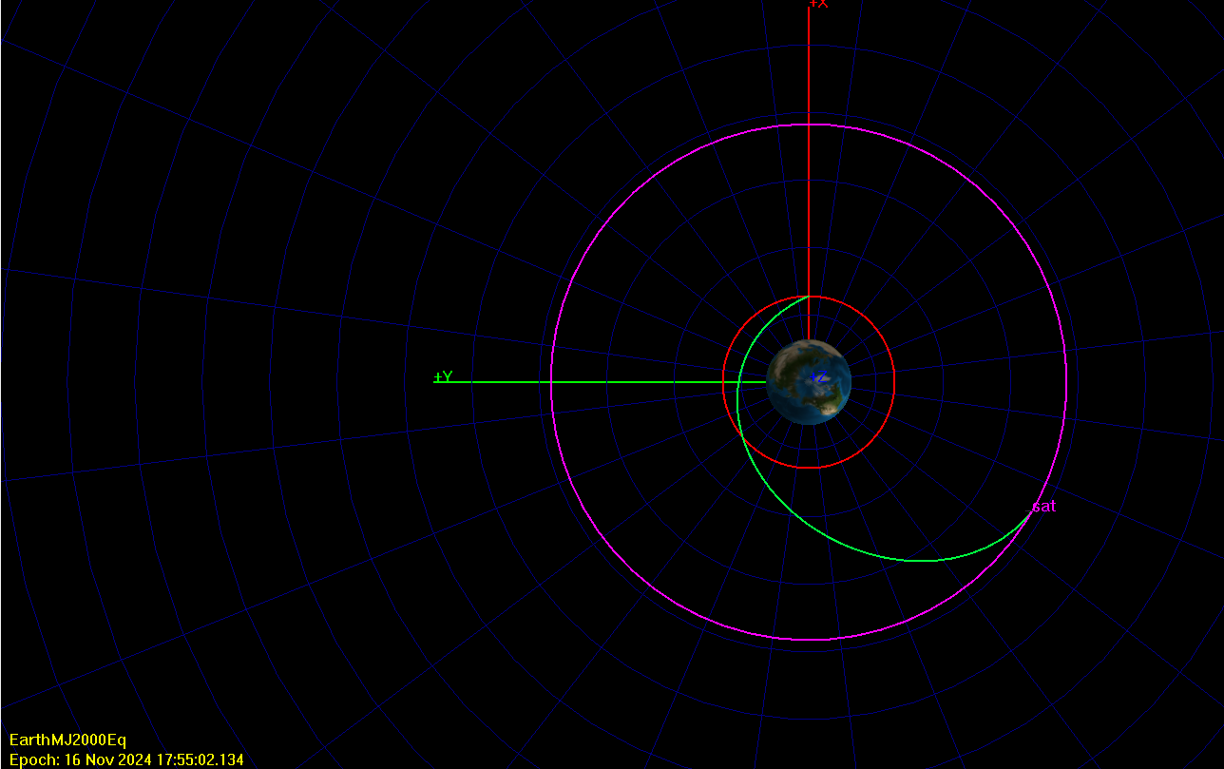






L.H
$$γ_{D}$$
$${\overline{r}}_{D}$$
$${\overline{v}}_{D}$$
Vacant Focus
L.H
$$γ_{A}$$
$${\overline{v}}_{A}$$
$${\overline{r}}_{A}$$

